Slide 1
C# Collections

Slide 2
Collection
Collections provide a more flexible way to work with groups of objects. Unlike arrays, the group of objects you work with can grow and shrink dynamically as the needs of the application change. For some collections, you can assign a key to any object that you put into the collection so that you can quickly retrieve the object by using the key.
A collection can provide various degrees of functionality.
At a minimum it needs to provide some mechanism to list or enumerate its members.

Slide 3
Collection Namespaces
The .NET framework provides several components that aid in using collections, either those directly implemented in .NET or your own custom collections.
The collection namespaces are:
Namespace | Contains
System.Collections | Nongeneric collection classes and interfaces.
System.Collections.Specialized | Strongly typed nongeneric collection classes.
System.Collections.Generic | Generic collection classes and interfaces.
System.Collections.ObjectModel | Proxies and base classes for custom collections.

Slide 4
Flavors of Collections
Scattered across these namespaces are components that:
Provide standard interfaces for working with a broad range of collection implementations.
Provide robust and complete concrete implementations for common data structures such as linked-lists, dynamic arrays and partial maps.
Provide wrappers around a few of these concrete classes for user customization.
Provide a wrapper or proxy that limits the accessibility to read-only.

Slide 5
Generic vs. non-Generic
The Generic collection interfaces and classes provide strong type safety and should almost always be preferred over the non-generic collections introduced in C# 1.0
Many of the generic interfaces are derived from the non-generic interfaces, so we will cover both.

Slide 6
Enumeration
Basic construct of any enumerator:
public interface IEnumerator
{
bool MoveNext();
object Current { get; }
void Reset();
}

Slide 7
IEnumerable
Collections in .NET use the Iterator Design Pattern, hence they do not implement IEnumerator.
Instead they implement IEnumerable.
Creates a new instance of an IEnumerator and returns it.
public interface IEnumerable {
IEnumerator GetEnumerator();
}

Slide 8
IEnumerable and IEnumerator
IEnumerable and IEnumerator are both interfaces. IEnumerable has just one method called GetEnumerator. This method retuns (as all methods return something including void) another type which is an interface and that interface is IEnumerator. When you implement enumerator logic in any of your collection class, you implement IEnumerable (either generic or non generic). IEnumerable has just one method whereas IEnumerator has 2 methods (MoveNext and Reset) and a property Current. For easy understanding consider IEnumebale a box that contains IEnumerator inside it (though not through inheritance or containment).

Slide 9
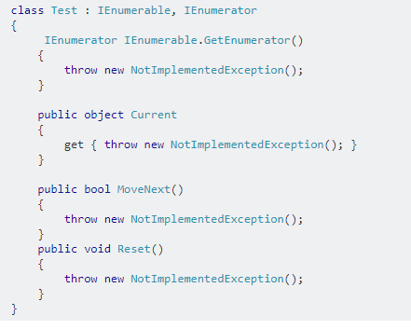
Example of IEnumerable and IEnumerator

Slide 10
Types of collection
There are the following 2 types of collections:
Non-Generic
Generic
Non-generic Generic
ArrayList -------------> List
HashTable -------------> Dictionary
SortedList -------------> SortedList
Stack -------------> Stack
Queue -------------> Queue

Slide 11
System.Collections Classes (Non generic)
The following table lists some of the frequently used classes in the System.Collectionsnamespace:
Class | Description
ArrayList | Represents an array of objects whose size is dynamically increased as required.
Hashtable | Represents a collection of key/value pairs that are organized based on the hash code of the key.
Queue | Represents a first in, first out (FIFO) collection of objects.
Stack | Represents a last in, first out (LIFO) collection of objects.
SortedList | Is a class that has the combination of arraylist and hashtable. Represents the data as a key and value pair. Arranges all the items in sorted order.

Slide 12
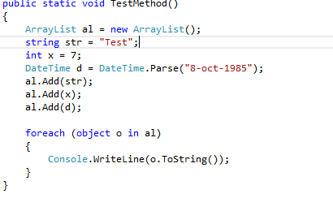
Example - ArrayList

Slide 13
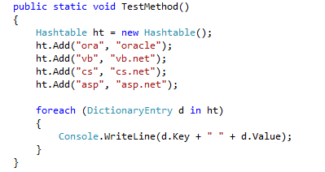
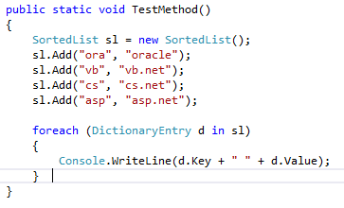
Example – HashTable and SortedList

